Slide 1


National Aeronautics and
Space Administration
High School Summer Intern Program Evaluation
Margaret Baguio
Notes:
Tell you a bit about NASA Science.

Slide 2
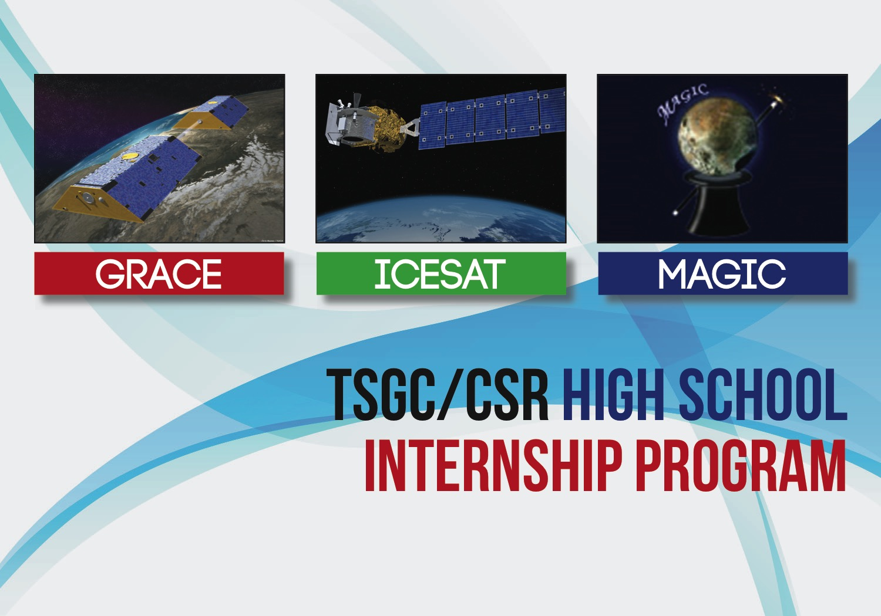
High School Summer Intern Program Evaluation
In follow-up evaluation with former interns that have participated in the UT/CSR and GRACE high school summer intern program we asked “How did participating in the internship program help you?” Here are a few responses:
This internship program helped as a foundation for my interest in Aerospace Engineering by learning about the multiple facets of this discipline and how it can be applied to things such as global warming. It increased my awareness of the importance of studying data from satellites.
My internship solidified my passion for space exploration and set me on my current path to contribute in that field. It helped me gain confidence in my teamwork and technical skills and has certainly factored into my successes since.
Participating in the internship was my first real experience with computer science and it helped me realize my passion for software engineering.
The internship helped me immensely in gaining experience and figuring out the direction I wanted to take in my studies. I enjoyed helping write scripts with my mentor, which led me to enroll in Computer Science. I also learned about climate and environmental changes happening in the world – knowledge I took with me to The White House when working on launching a climate education initiative. It was definitely a turning point for where I see myself in the future!
The internship program did a few things for me – it gave me my first real experience working on a research project, and, more importantly exposed me to the wonderful world of space observations of Earth. It led me to my degree in Environmental Science.
Evaluation compiled by Margaret Baguio, GRACE EPO Lead
January 8, 2016

