Slide 1


National Aeronautics and
Space Administration
High School Summer Intern Program Evaluation
Margaret Baguio
Notes:
Tell you a bit about NASA Science.

Slide 2
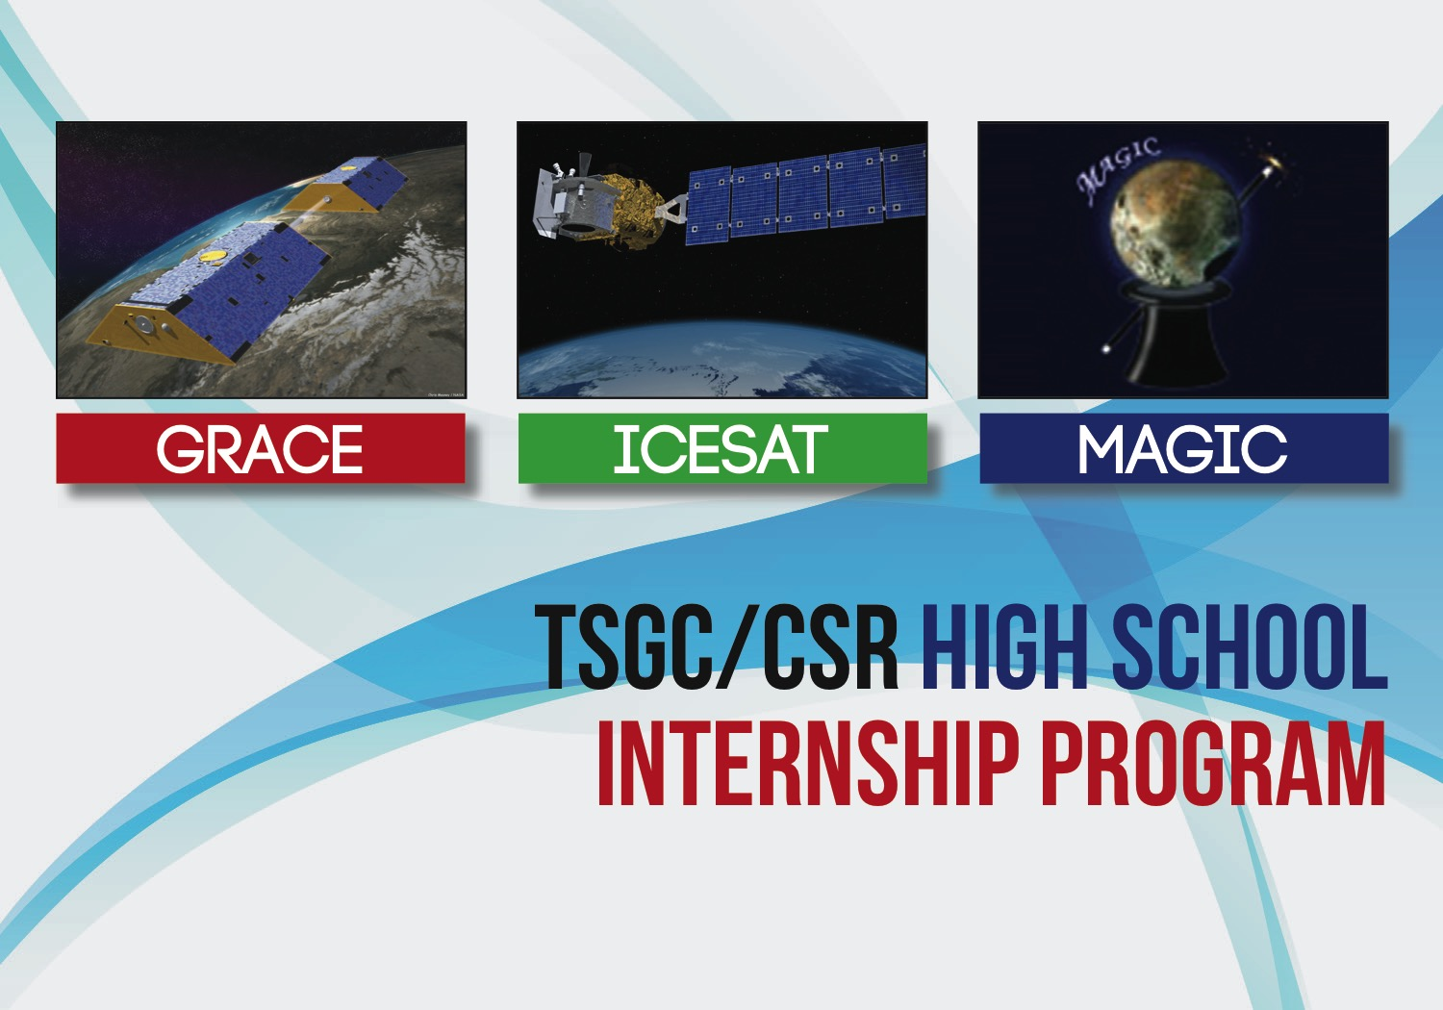
High School Summer Intern Program Evaluation
In follow up evaluations of the UT/CSR high school internship program, we asked participants to list internships or accomplishments while in college.
Here are a few responses:
Co-designed the Innovation Station, a free and automated 3D printing vending machine that provides access to 3D printing for all students on campus.
Team lead for the Women in Aerospace for Leadership Development (WIALD) project based organization.
Selected for the Turing Scholars Honor Program for Computer Science Majors.
Microsoft, Explore Program Intern and then interned at The White House in the Office of Science and Technology Policy Division where I launched The White House Women in STEM site: https://www.whitehouse.gov/administration/eop/ostp/women and the Climate Education and Literacy Initiative: https://www.whitehouse.gov/sites/default/files/microsites/ostp/climateed-dec-3-2014.pdf . I will be joining the Microsoft Skype team upon graduation this year.
Evaluation compiled by Margaret Baguio, GRACE EPO Lead
January 8, 2016

