Slide 1
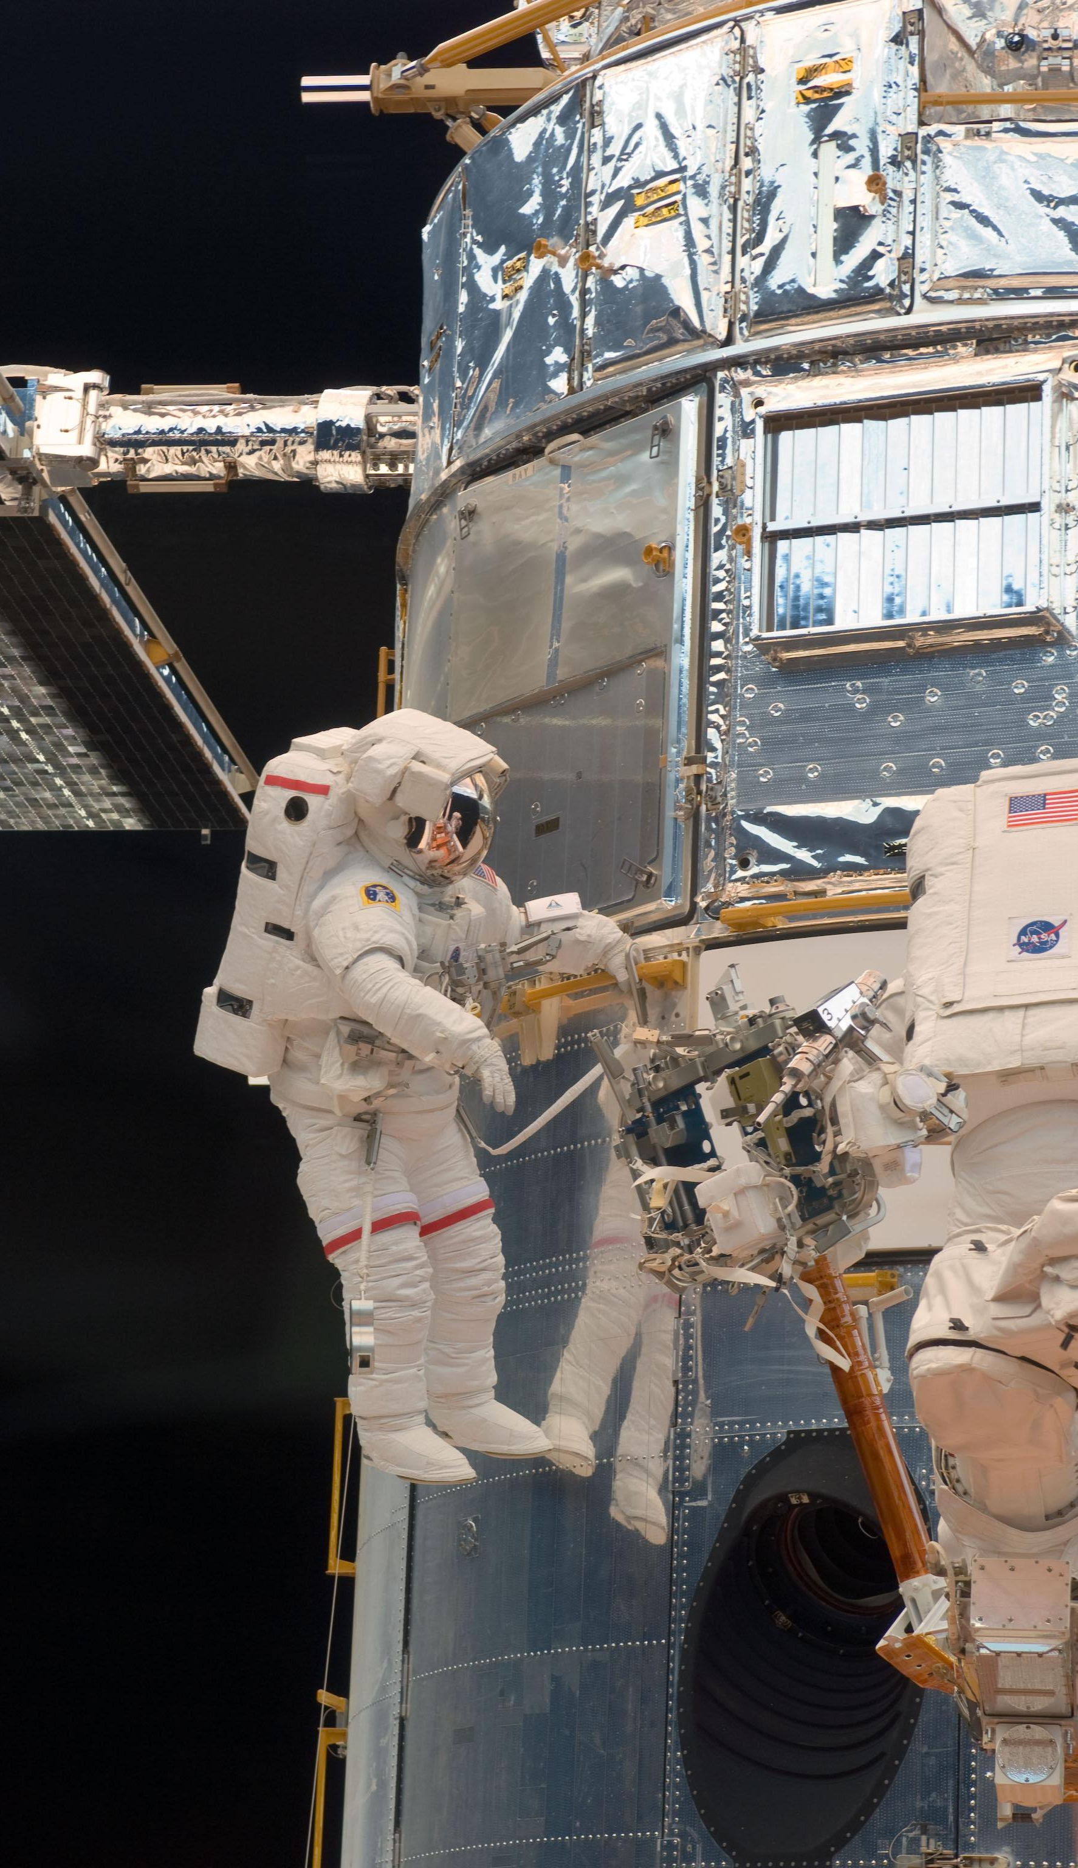

Margaret Baguio
Sr. Education/Outreach Coordinator
NASA Texas Space Grant Consortium

Slide 2
NASA Texas Space Grant Consortium
58 members to include universities, colleges, junior colleges, government, non-profits, and industry
The Texas Space Grant Consortium, formed in 1989, has as its objectives to:
Foster sharing of space related course materials among consortium academic institutions
Foster the development of multi-institutional space research efforts including industry-university teaming
Foster high quality graduate level space research at consortium academic institutions
Use interest in space to increase participation in science and mathematics in the public schools
Foster space-related programs and curricula for public schools and for the public
Increase the pool of high school graduates who enter college to study science, mathematics, and engineering with emphasis on underrepresented minorities and women

Slide 3
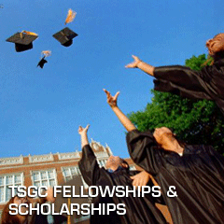

NASA Texas Space Grant Consortium
Major programs:
Fellowship and Scholarship
Design Challenge
Mini-grants: Research, K-12, New Investigator
K-12 Education

Slide 4
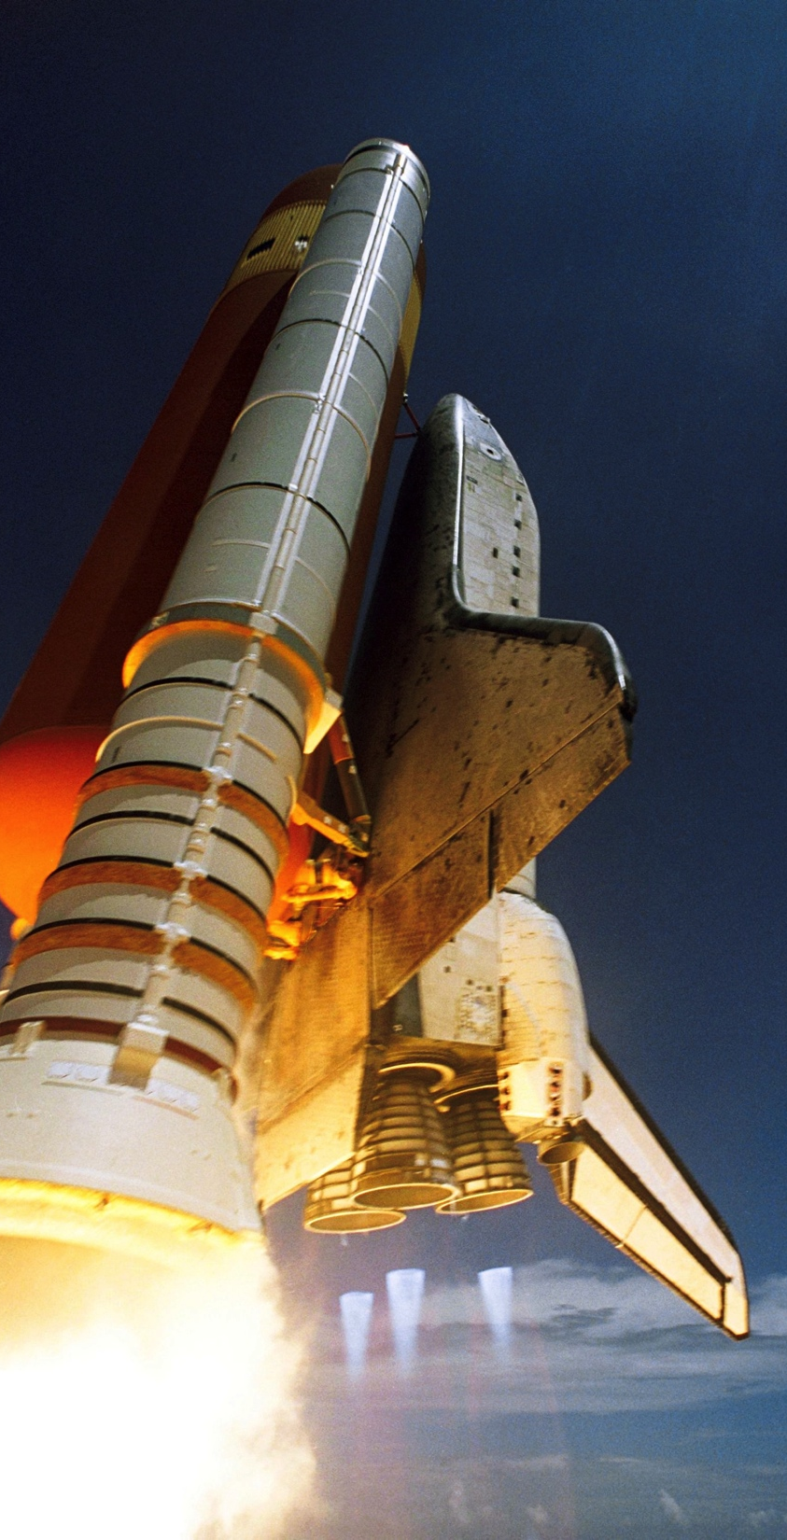


NASA LiftOff
Professional Development Institute
Margaret Baguio
Sr. Education/Outreach Coordinator
NASA Texas Space Grant Consortium

Slide 5
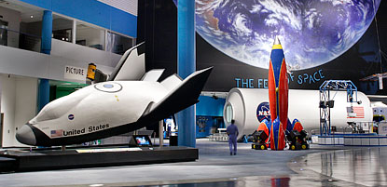
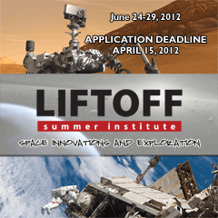
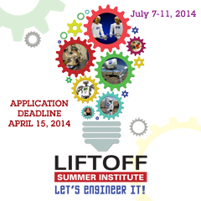
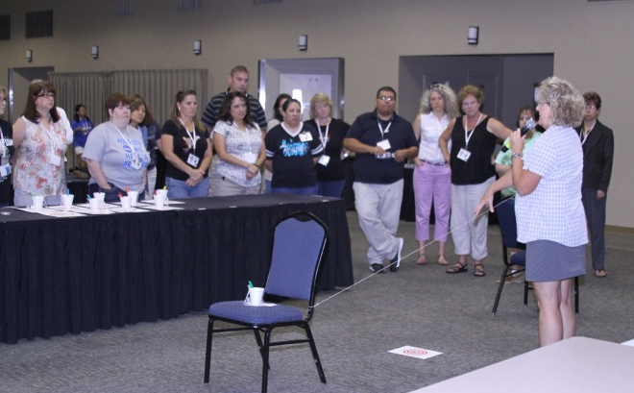
NASA LiftOff Institute
Sponsored by NASA Texas Space Grant Consortium
Nationally competitive program
Held at NASA Johnson Space Center
Theme changes each year
Middle and High School STEM Teachers
Train-the-trainer workshop
Notes:
Beginning in the summer of 1990, the NASA's Texas Space Grant Consortium initiated weeklong professional development training for teachers. This aerospace workshop, called LiftOff, emphasizes science, technology, engineering, and mathematics (STEM) learning experiences by incorporating a space science theme supported by NASA missions. In 2013 we began partnering with NASA Johnson Space Center and the Middle School Aerospace Scholars program. That partnership continues. Teacher participants are provided with information and experiences through speakers, hands-on activities and field investigations that promote space science and enrichment activities for themselves and others.

Slide 6
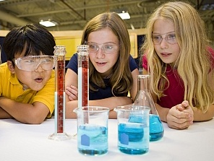
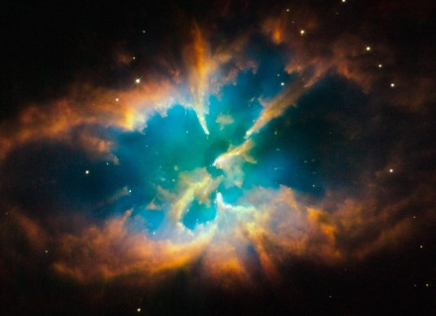
Objectives
In support of K-12 Education, the Texas Space Grant Consortium has the following program goals:
Assist K-12 teachers in exciting their students to learn math and science though space based activities.
Increase K-12 educator knowledge in space related fields.
Increase K-12 students knowledge in math and science through space related activities.
Increase the public’s appreciation for the direct and indirect benefits of NASA sponsored research.

Slide 7

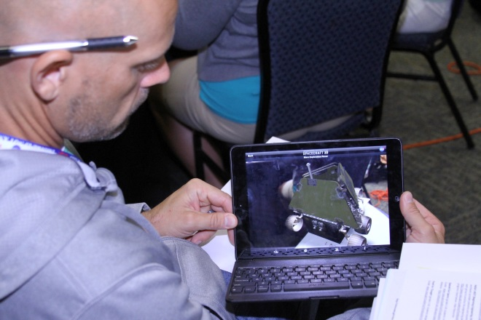
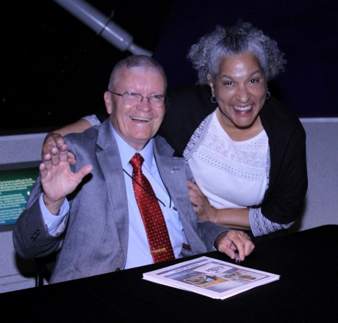
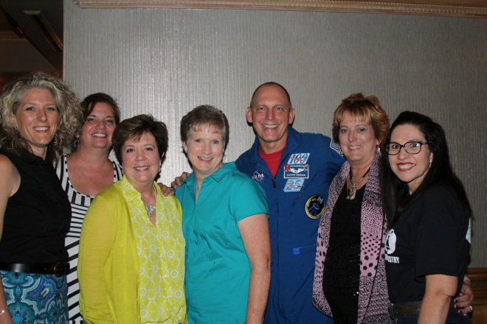
Resources
Speakers
Curriculum
On-line resources
Projects and activities
Handouts

Slide 8
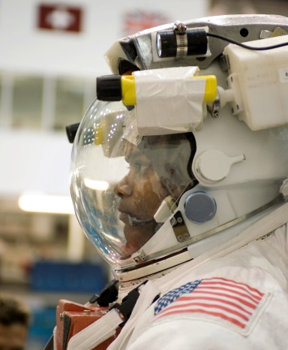
Application process
Basic background information:
What is your formal education and teaching experience?
What is your current assignment?
List professional activities.
Other teacher-related activities.
If you have never attended the LiftOff Summer Institute before –
in 100 words minimum, 500 maximum:
What do you expect to gain from attending the LiftOff Summer Institute?
What are some ways you would incorporate space science materials into your classroom?
How would you share the information you receive with fellow educators?
Why would you like to be selected for the LiftOff Summer Institute
If you are a LiftOff Alumni - in 100 words minimum, 500 maximum:
How have you used the LiftOff information, lessons, and resources with students?
In what ways have you shared the LiftOff information with fellow educators?
How has the LiftOff Summer Institute helped you as a teacher?
Why would you like to be selected to return for the LiftOff Summer Institute?

Slide 9
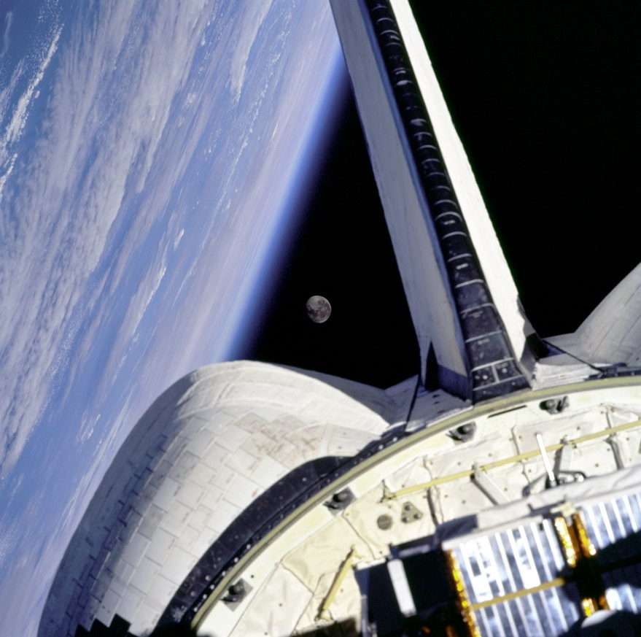
Selection
Applications grouped by grade level
Each group is reviewed – 3 judges
Scores averaged
Highest scoring applications are invited to attend

Slide 10
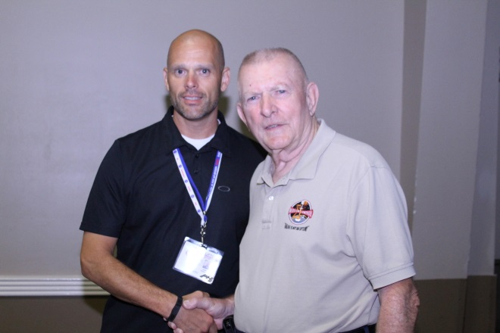
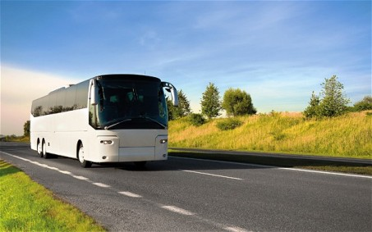
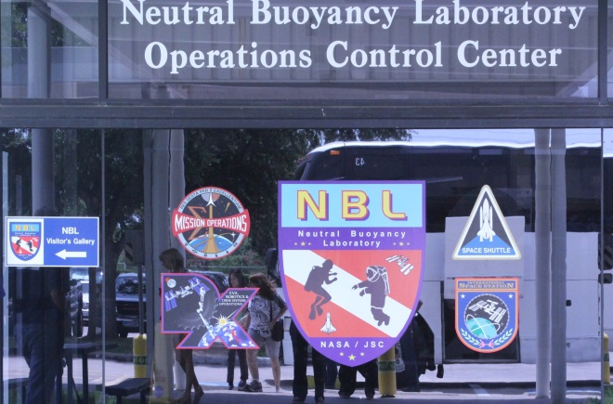

Logistics
Committee selects speakers, activities, and events
Budget
Book venues
Travel arrangements
Bus schedule
Notebooks

Slide 11
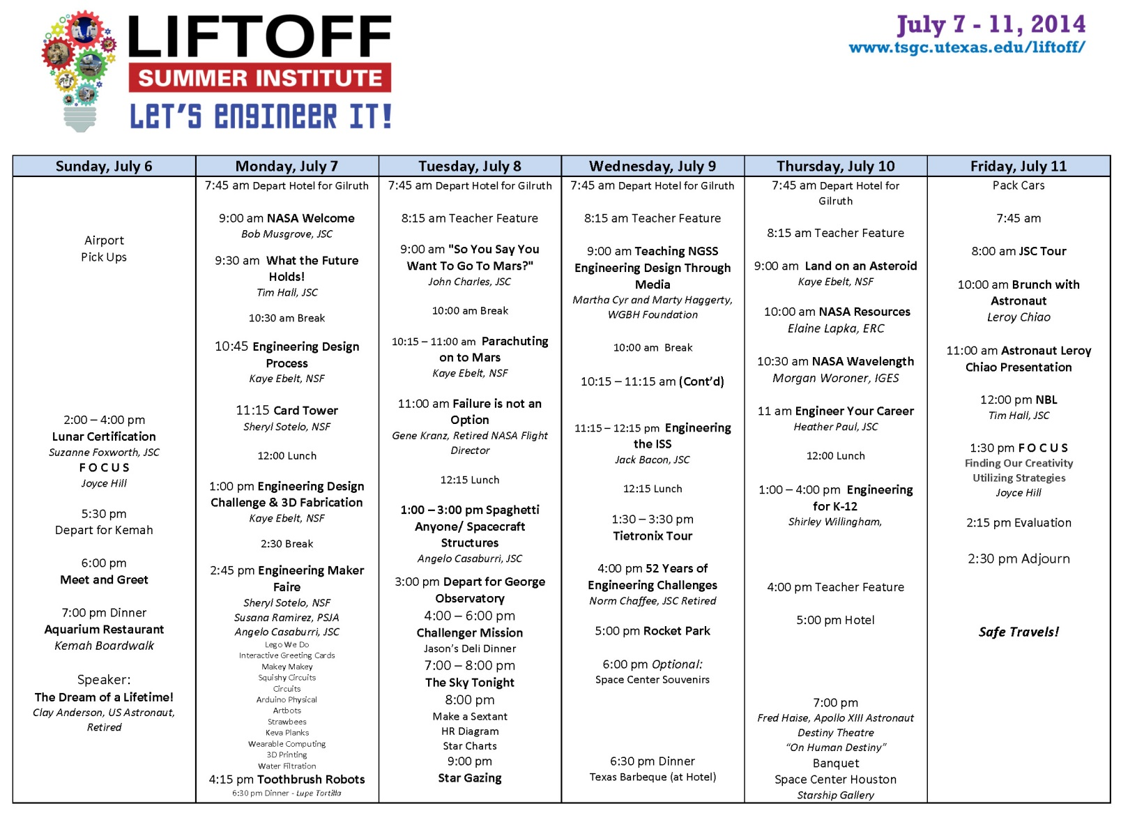
Schedule

Slide 12

Evaluation
In-depth program evaluation
Logistics evaluation
Needs assessment
Monthly newsletter
Follow-on survey

Slide 13
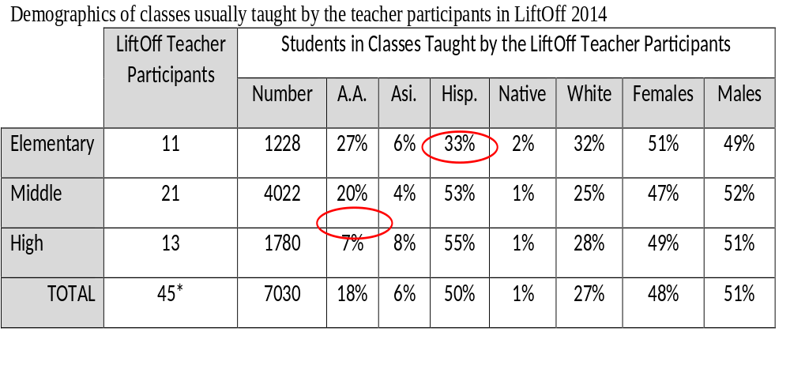

Demographics

Slide 14



Impact
By following through on plans the teachers expressed for using resources and learning obtained, teachers will reach:
7,000
Students
1,000 Fellow
Teachers
Numerous
Indirect Contacts

Slide 15
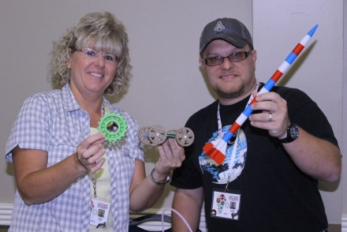
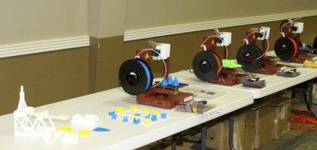
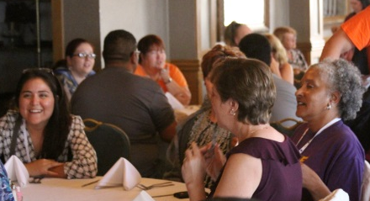
Overall LiftOff Experience
Endorsement of Liftoff as “the best” professional development
Expression of definite intentions to plan and integrate gained information into their classrooms
Wishes for training to include more opportunity for networking with other teacher participants, plans for using resources
Notes:
There were three themes in teacher participants’ personal statements about the overall experience of LiftOff and their plans for using the resources and learning they obtained: (1) endorsement of LiftOff 2014 as “the best” professional development; (2) expression of definite intentions to plan and integrate gained information into their classrooms; and (3) wishes for the training to include more opportunities for networking with the other teacher participants and making formal plans for using the resources and learning obtained.
Theme 1. LiftOff was experienced as “the best” professional development
LiftOff was spectacular: great activities, amazing and awesome speakers
THIS was the experience of a lifetime.
This was the most important and eye opening professional development I have ever done.
An excellent program that was informative and inspiring. Best training for teachers!
Beyond my wildest dreams! Amazing week!
This is the BEST conference I have ever attended in my 17 years of teaching.
Theme 2. Teacher participants expect to integrate the resources and activities into their classrooms.
I can’t wait to add some of the lessons to my curriculum.
You have given me a great springboard to better assist my students, my school, and my district.
Will embed materials into lessons, my after school program, and share with colleagues.
Can’t wait to plan and integrate gained information.
I can’t wait to go back to my district and share with coordinators.
Theme 3. Desire was expressed for increased networking and planning with the other participants.
The only improvement I would suggest is making us mix it up more—we formed little groups and I feel I barely got to speak to some of the participants.
I wish the day ended at 6:00 pm to allow for meet and greet at the hotel.
A little time to assimilate information on a daily basis might be considered. Discussion w/colleagues in an informal setting does wonders for understanding and implementation.

Slide 16

Coming in 2015….
http://www.tsgc.utexas.edu/liftoff

Slide 17
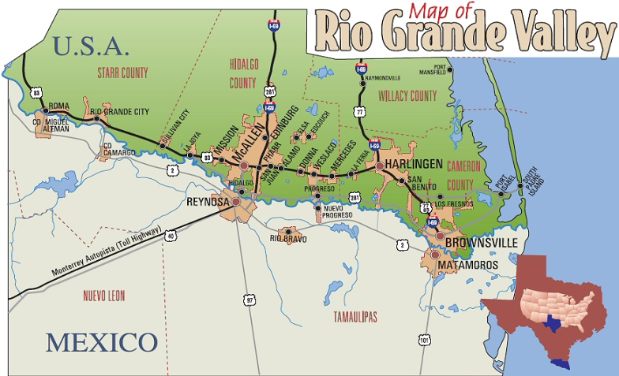
Imagine Now …
Innovate for the Future
Rio Grande Valley Science Association
What is NASA Summer of Innovation?
Targets rising Grade 4 – 9 students
Brings high quality, exciting STEM educational programs and activities to the Rio Grande Valley
Uses NASA’s out-of-this-world missions and technology programs to boost summer learning
Vision:
Advance excellence in summer and extended learning for under-represented and underserved middle school students to inspire them toward future STEM pursuits.
Mission:
Strengthen efforts by providers that engage underrepresented and underserved middle school students in STEM learning by using exciting and rigorous NASA-based instructional resources, experiences and support tailored to local needs.

Slide 18
Imagine Now …
Innovate for the Future
Rio Grande Valley Science Association
Collaborators:
Partners with the Rio Grande Valley Science Association (RGVSA) include :
9 school districts throughout the Rio Grande Valley
Two institutes of higher education – The University of Texas Pan American and The University of Texas at Austin
Texas Space Grant Consortium
Texas Education Agency
Time Warner Cable
The Texas Girls Collaborative Project through UT Women in Engineering
PSJA – TTIPS school
Albert I. Pierce Foundation
Boys and Girls Clubs in the Rio Grande Valley
Program began in summer 2011. We have offered NASA-themed summer programs for youth in the Rio Grande Valley for four years. A total of 10,075 have participated in week-long camps.
Year 1 2,691 youth 151 teachers
Year 2 2,497 youth 134 teachers
Year 3 2,617 youth 115 teachers 25 informal
Year 4 2,270 youth 83 teachers 22 informal

Slide 19


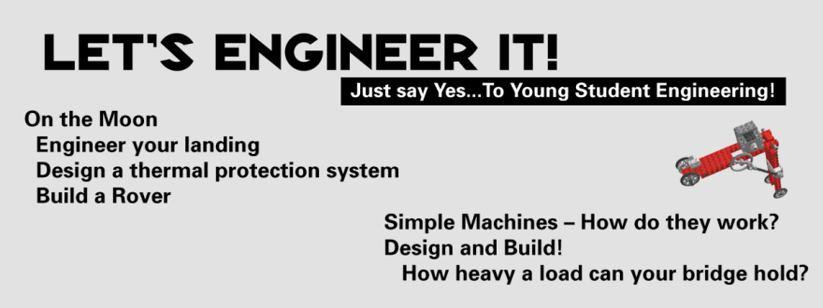


Imagine Now …
Innovate for the Future
Camp Themes

Slide 20
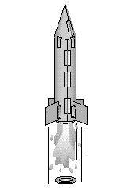
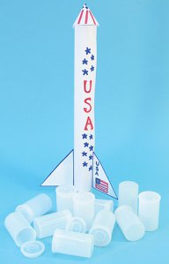
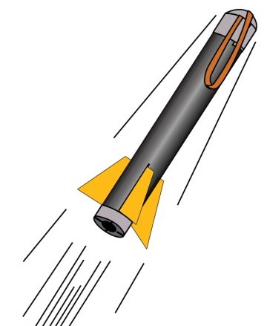


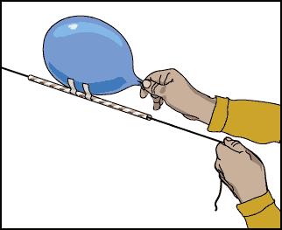
3, 2 ,1 . . . BLAST OFF
Sample camp activities we’ve done:
Paper Rocket
Alka-Seltzer Rocket
Foam Rocket
Glider
Table-top
Hovercraft
Balloon
Rockets

Slide 21
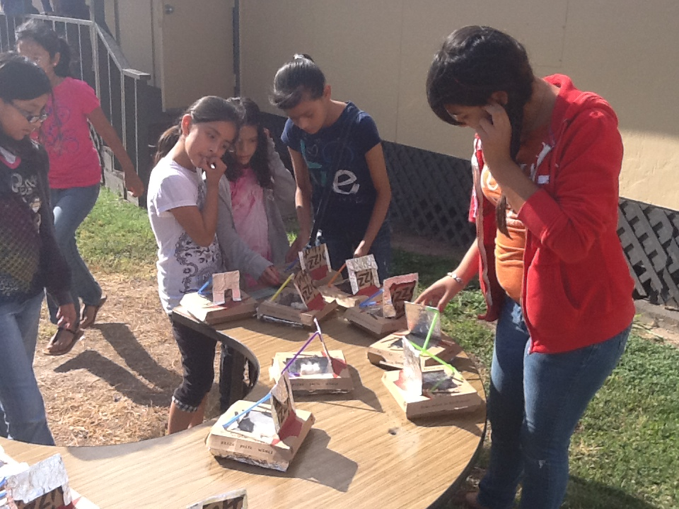

Living in Space
Sample camp activities:
Get a Leg Up
Solar Ovens
Water Filtration
Train Like an Astronaut
Solar Ovens: Students observing projects for changes in physical properties.

Slide 22
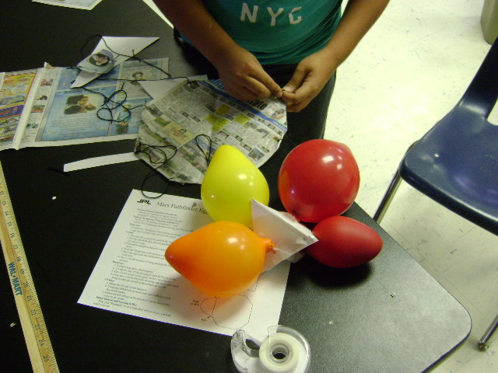
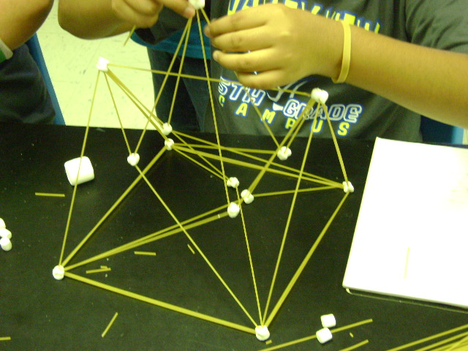
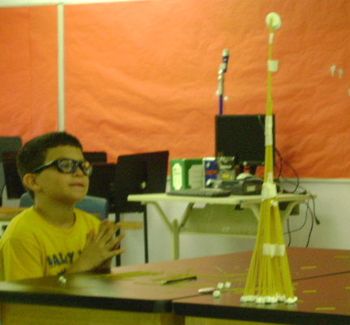
Let’s Engineer It!
Sample camp activities:
Paper Tower
Mars Lander
Spaghetti Tower
Rover
Hot Chocolate Machine

Slide 23
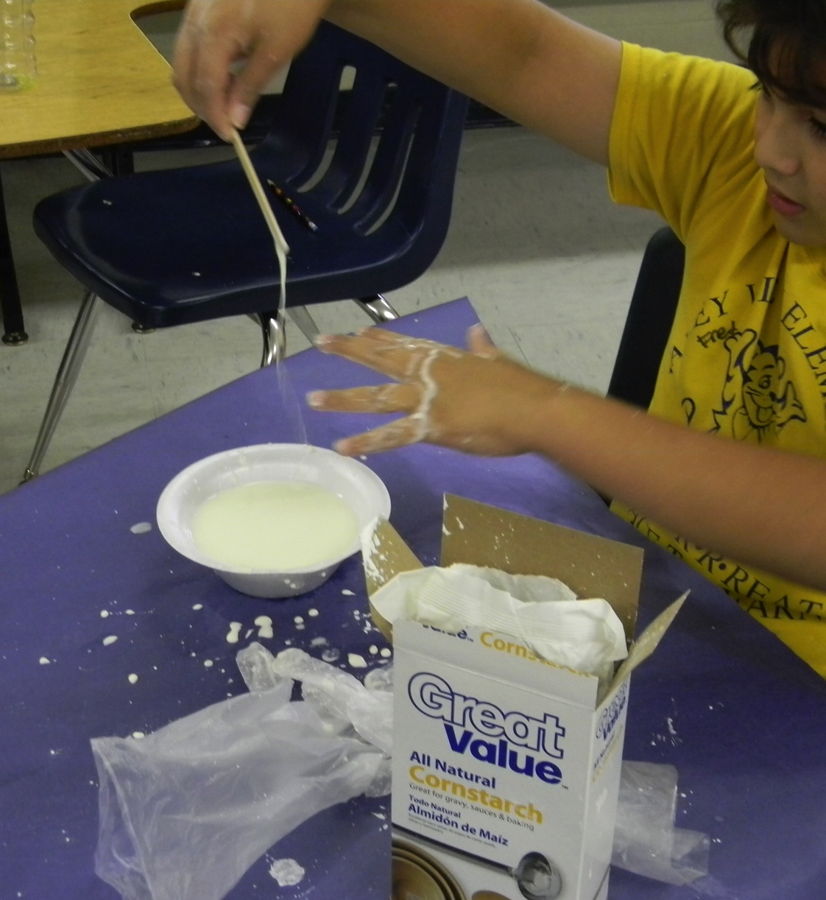
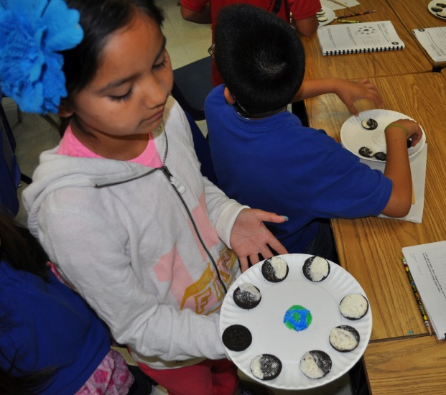
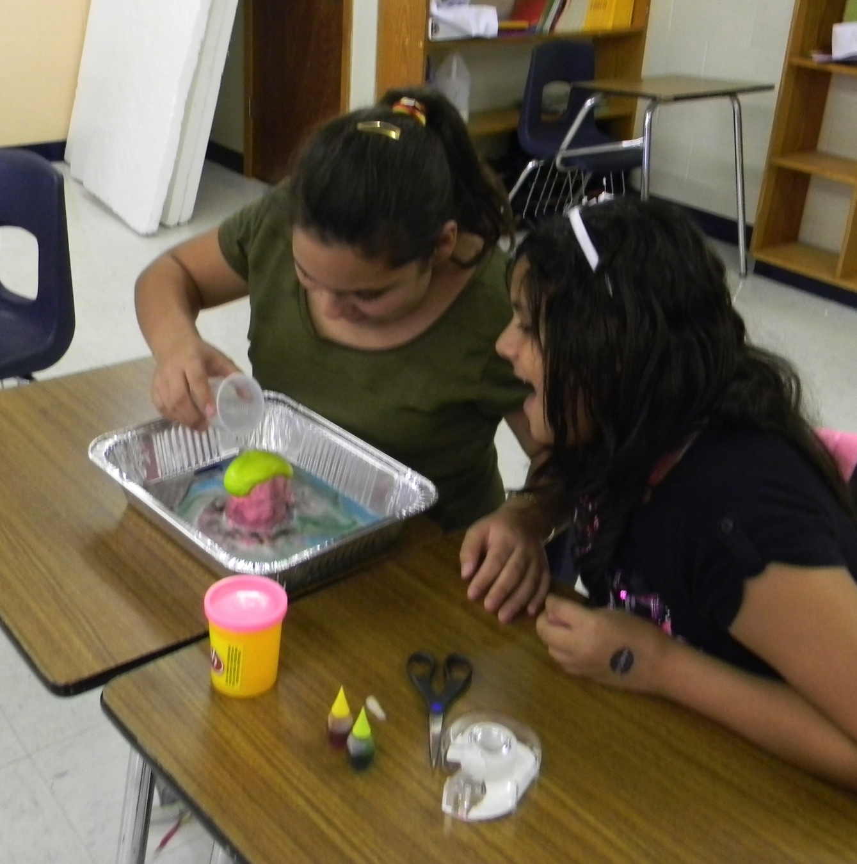
Trekking in Space
Sample camp activities:
Mars Lava Layering
Star Classification
Oobleck: Exploring Other Worlds
Earth/Moon System
Phases of the Moon

Slide 24
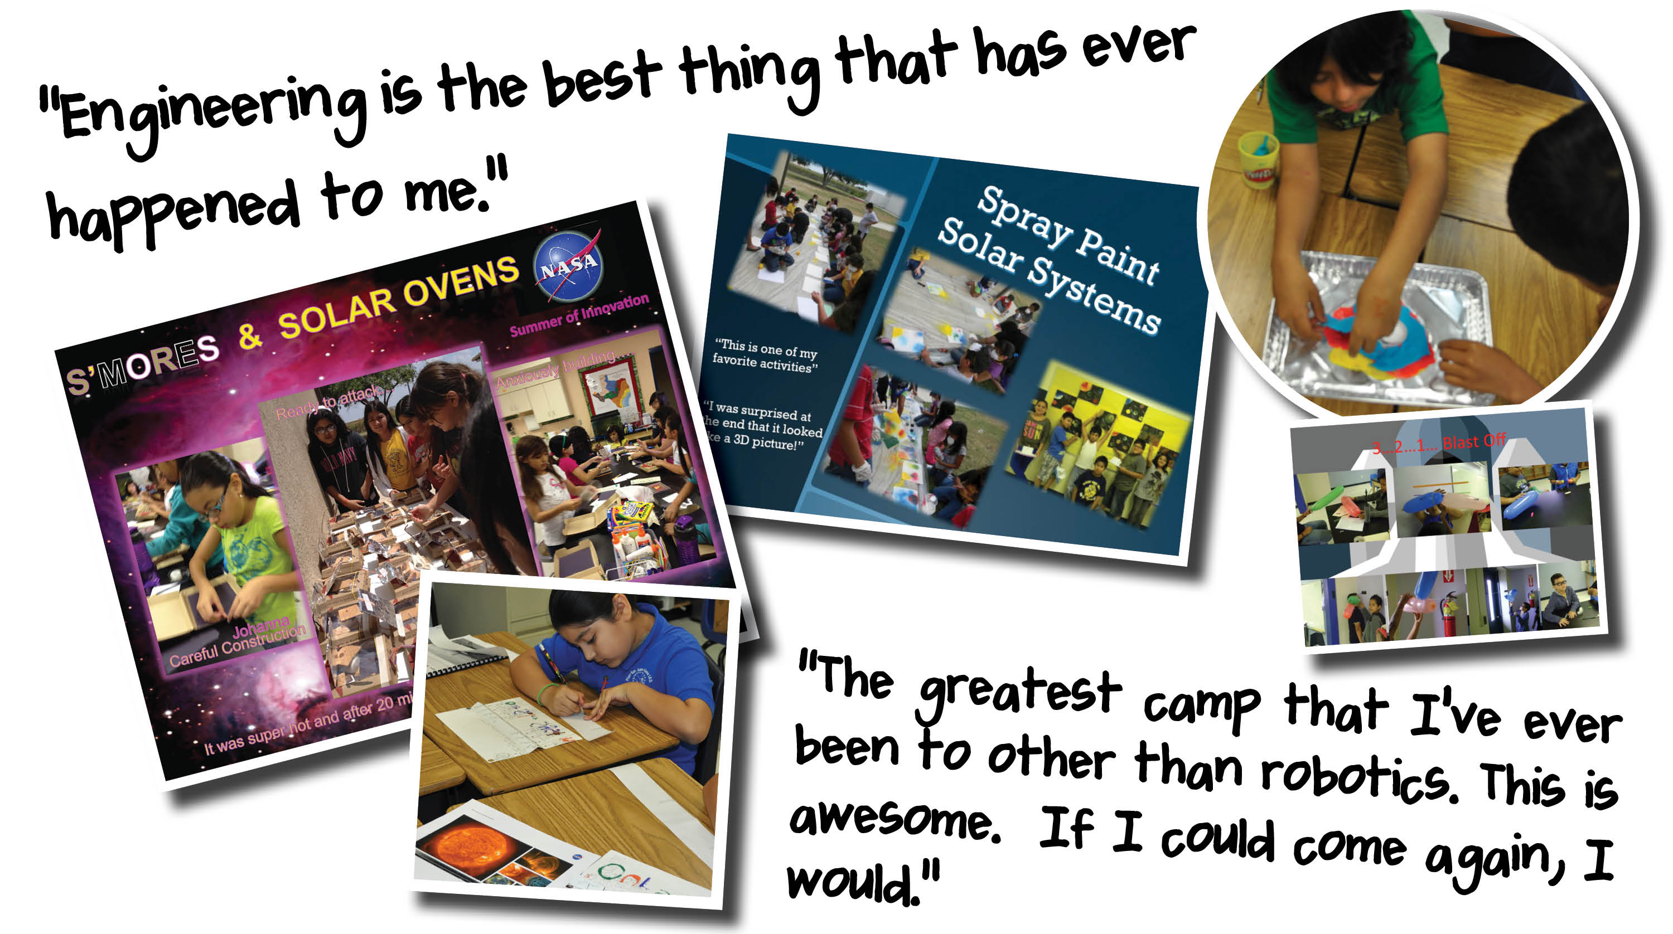

Slide 25
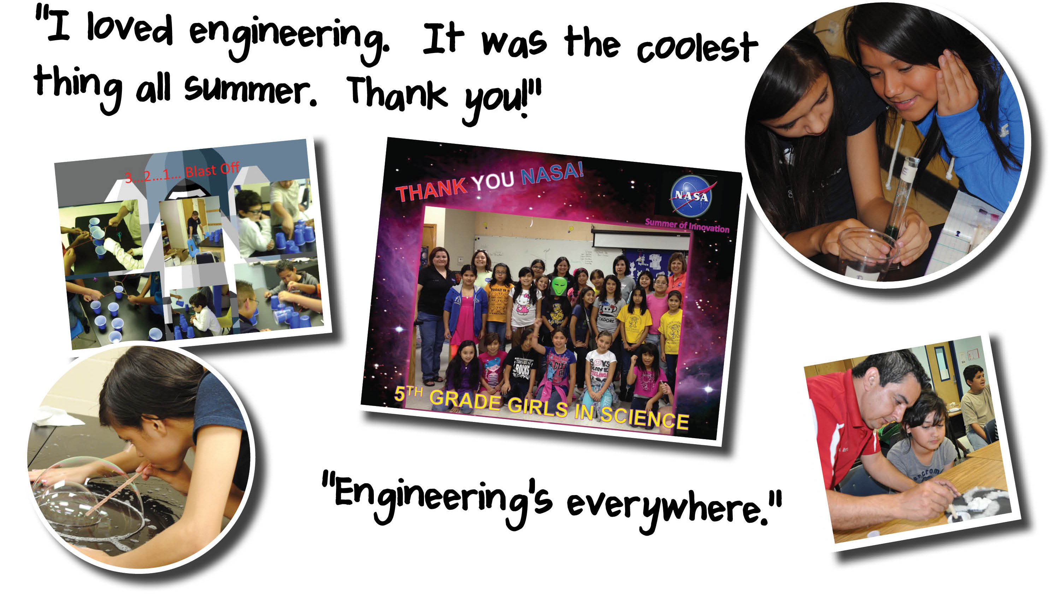

Slide 26


M is for Math … in STEM
Judit Györgyey Ries
Margaret Baguio
UT at Austin/Center for Space Research

Slide 27
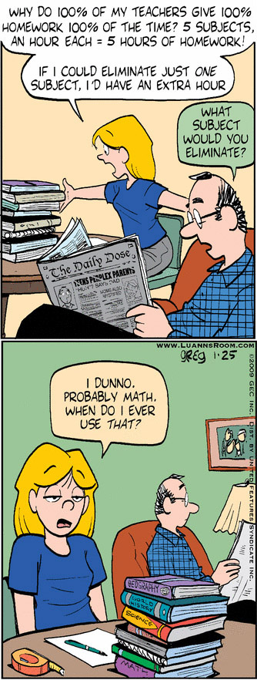
Students usually do not see the relevance of the subject as presented in textbook problems. They do not see the connection to their life or to their future carrier.
Our aim is to overcome the apprehension many students feel when faced with abstract mathematics.
To achieve this we conduct a series of professional development workshops for team of teachers, a math and a science teacher from the same school, in the application of mathematical principles to Astronomy and Space Science.
We are providing the teams with discovery type activities, in which they work with numbers, create graphs to interpret results, solve problems or make predictions.

Slide 28

Provide the mathematical and science background of selected activities, in order to further the STEM initiative, to bring students from underprivileged areas into higher education.
Give strategies and improved teaching methods for educators in astronomy and engineering to excite the interest of students by engaging them in hands on activities in the classroom with appropriate mathematical component.
Supply lesson plans and activities for teaching the concepts addressed during the workshop to those interested in implementing.
Create grade-level appropriate activities, which address state and national educational standards for the participating teachers.

Slide 29

Selected Activities
Lost: Charting the island – getting acquainted with topographic maps.
When is the next Full Moon? – Introduction to periodic phenomena, calculating periods, making predictions.
Which star am I? Getting familiar with graphs using the HR diagram,
How fast is that continent moving? – learning about motion while studying plate tectonics.
Destination Mars – What makes those rockets go?

