Slide 1
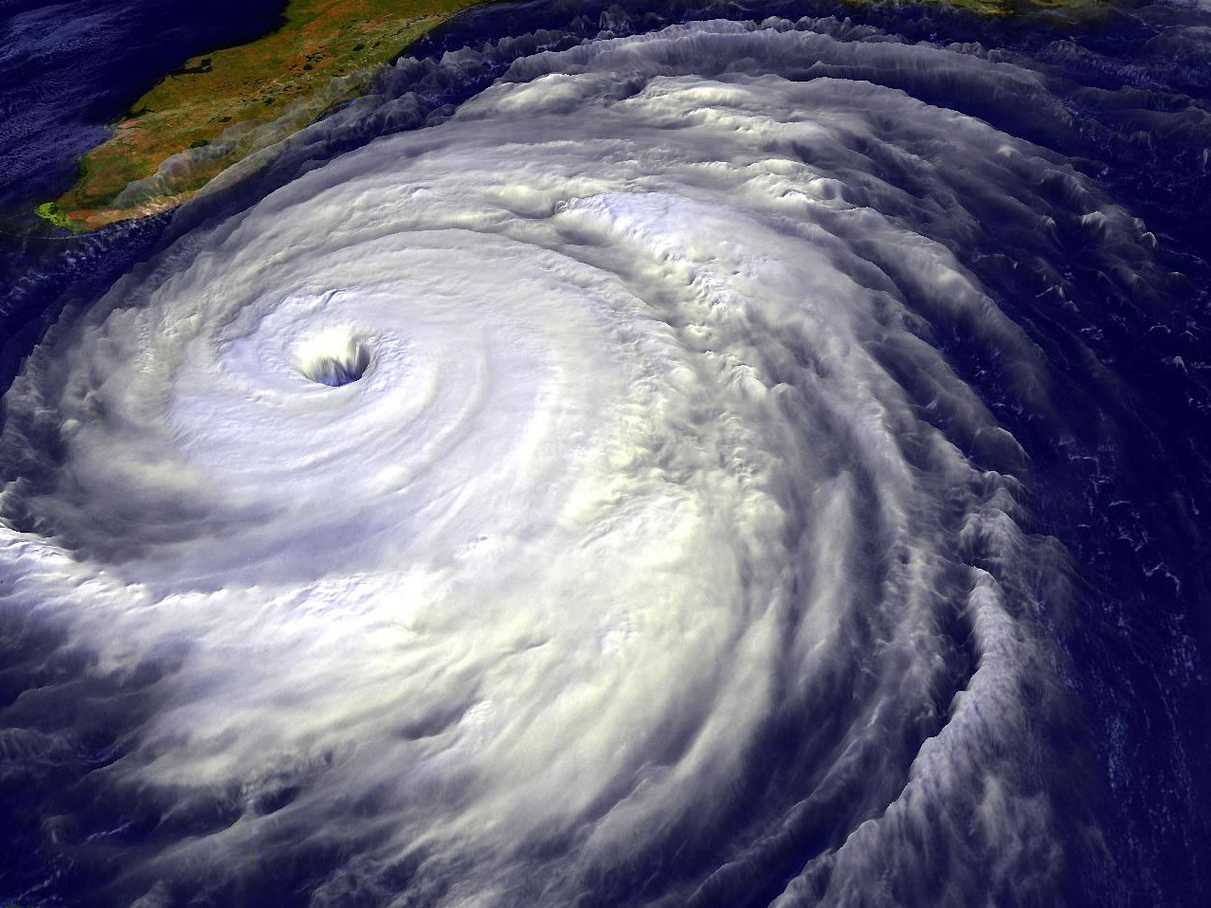
HURRICANES
Presented by Margaret Baguio
Texas Space Grant Consortium

Slide 2
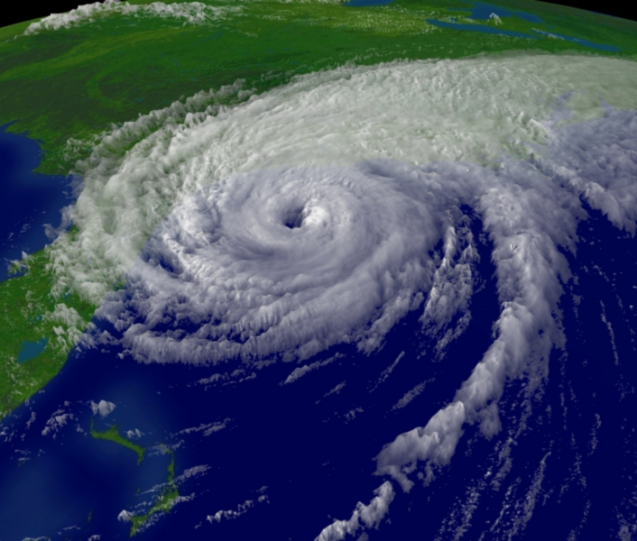
HURRICANES
A hurricane is a huge storm! It can be up to 600 miles across and have strong winds spiraling inward and upward at speeds of 75 to 200 mph. Each hurricane usually lasts for over a week, moving 10-20 miles per hour over the open ocean. Hurricanes gather heat and energy through contact with warm ocean waters.

Slide 3
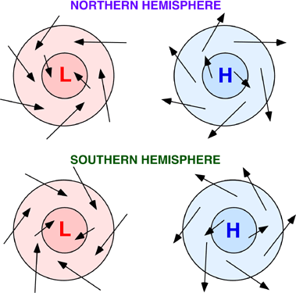
CYCLONES
A cyclone is a system of winds rotating inward to an area of low atmospheric pressure, with a counterclockwise (northern hemisphere) or clockwise (southern hemisphere) circulation; a depression.

Slide 4
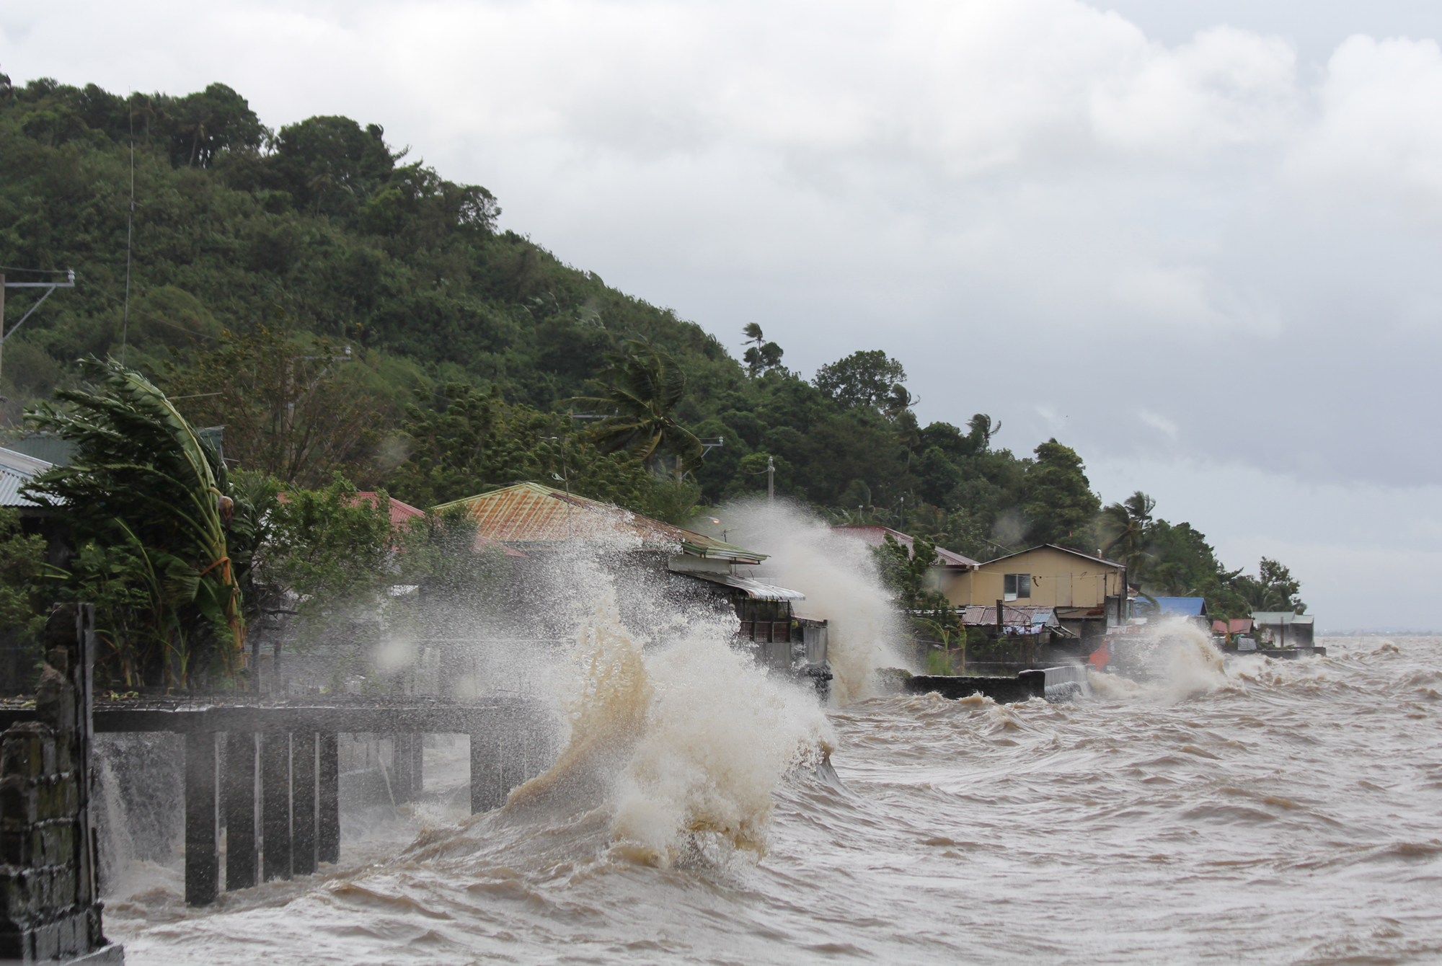
TYPHOONS
A typhoon is a tropical storm in the region of the Indian or western Pacific oceans.

Slide 5
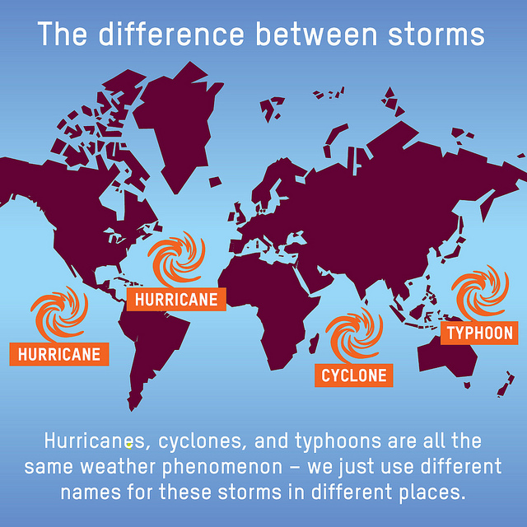
Hurricane? Cyclone? Typhoon?
They're all the same, officially tropical cyclones. But they just use distinctive terms for a storm in different parts of the world. Hurricane is used in the Atlantic, Caribbean Sea, central and northeast Pacific. They are typhoons in the northwest Pacific. In the Bay of Bengal and the Arabia Sea, they are called cyclones. Tropical cyclone is used in the southwest India Ocean; in the southwestern Pacific and southeastern India Ocean they are severe tropical cyclones.

Slide 6
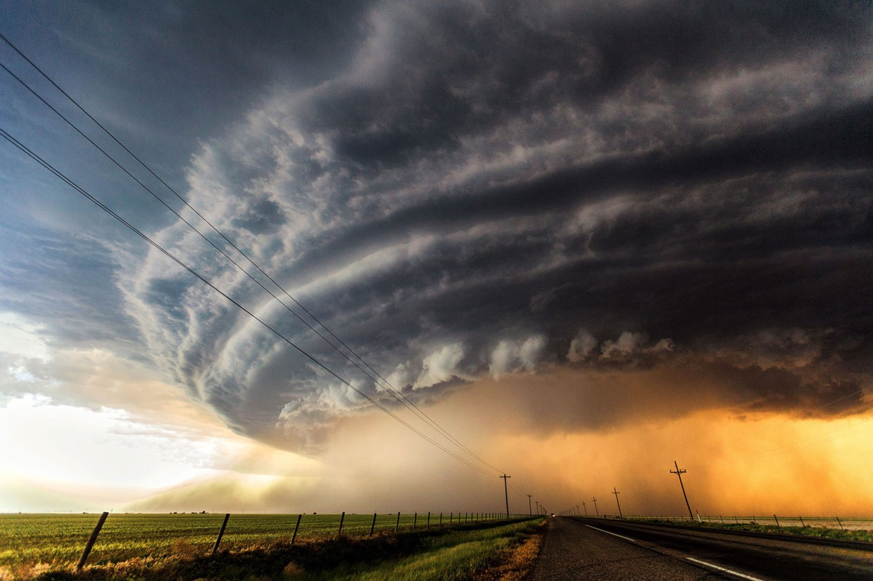
Storm Strength
STRENGTH: A storm gets a name and is considered a tropical storm at 39 mph (63 kph). It becomes a hurricane, typhoon, tropical cyclone, or cyclone at 74 mph (119 kph). There are five strength categories, depending on wind speed. The highest category is 5 and that's above 155 mph (249 kph). Australia has a different system for categorizing storm strength.

Slide 7
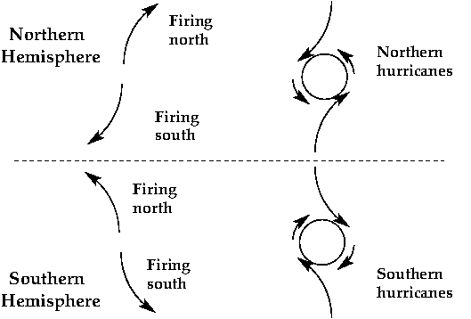
Rotation of a Hurricane
ROTATION: If they are north of the equator they rotate counter-clockwise. If they are south, they rotate clockwise.

Slide 8
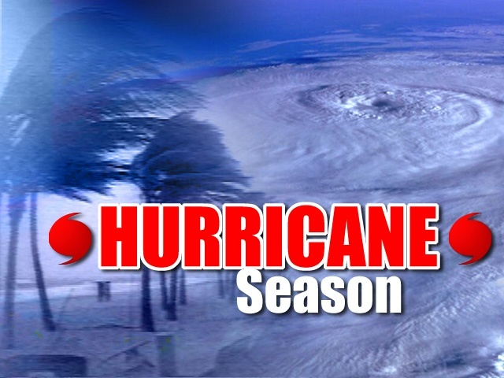
Hurricane Season
SEASON: The Atlantic and central Pacific hurricane seasons are June 1 through Nov. 30. Eastern Pacific: May 15 to Nov. 30; northwestern Pacific season is close to all year, with the most from May to November. The cyclone season in the south Pacific and Australia runs from November to April. The Bay of Bengal has two seasons April to June and September to November.

Slide 9
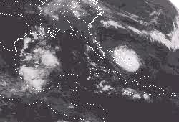
Hurricanes
What is the direction of the hurricane’s motion?
What land area does Hurricane Andrew move over?
What do you think causes a hurricane to speed up or slow down?
Do you think hurricanes speed up or slow down while over land?
Notes:
In the first movie, what is the direction of the hurricane’s motion? (Counterclockwise.)
What land areas does Hurricane Andrew move over? (The West Indies, Caribbean, Florida, Louisiana, and others.)
What do you think causes hurricanes (or other things in life) to speed up or down? (As noted in the benchmark, "changes in speed or direction of motion are caused by forces. The greater the force is, the greater the change in motion will be. The more massive an object, the less effect a given force will have.")
Do you think hurricanes speed up or slow down while over land? (Hurricanes lose power and slow down as they come over land.)

Slide 10
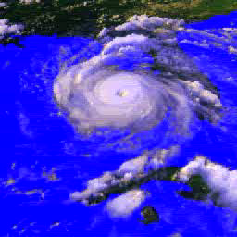
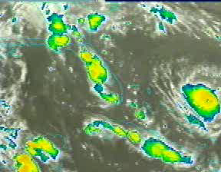
Hurricane Andrew
What do you think it was like in Florida and Louisiana on the day Hurricane Andrew struck these areas?

Slide 11
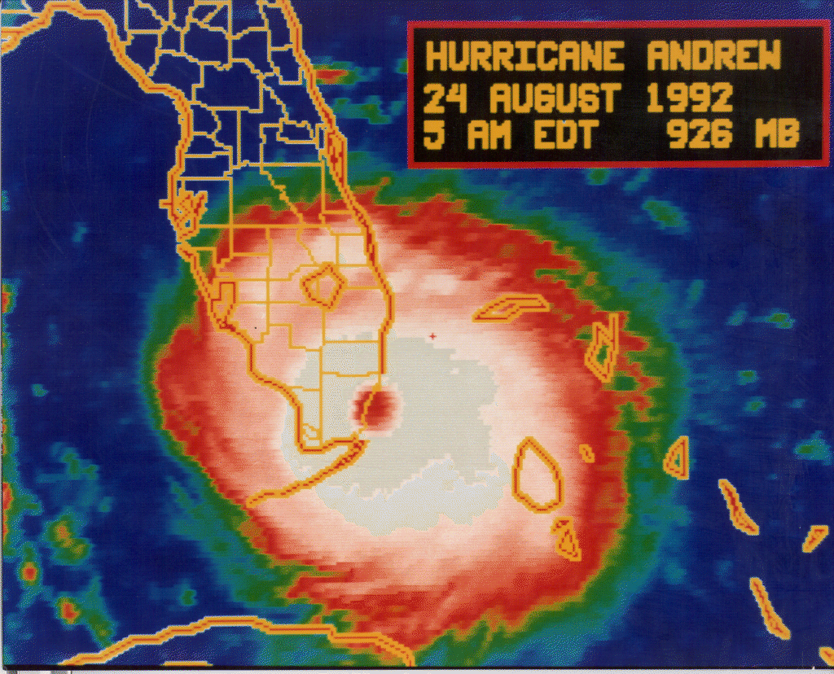
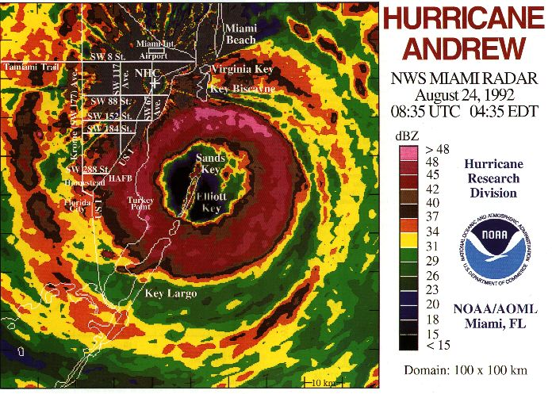
Hurricane Andrew
What do you think the effects were in Florida from Hurricane Andrew?
Notes:
Andrew's History
Andrew began as a patch of thunderstorms over western Africa. It moved out over the Atlantic as a rainy low-pressure wave. The U. S. National Hurricane Center tracks 60 or 70 of these waves each hurricane season, June through November, using satellites. By Monday, August 17 it had intensified into a tropical storm, developing a swirling circulation, but not yet the clear eye of a strong hurricane. By Friday, August 21, pushed westward by a high pressure zone to the north, Andrew built strength over the open ocean. On Saturday, Andrew's winds reached hurricane (74 mph) strength and grew stronger as it approached the coast of Florida.
Discuss the following questions:
How would you describe the damage the hurricane created in the area?
What do you think happened to the people living in those areas?

Slide 12
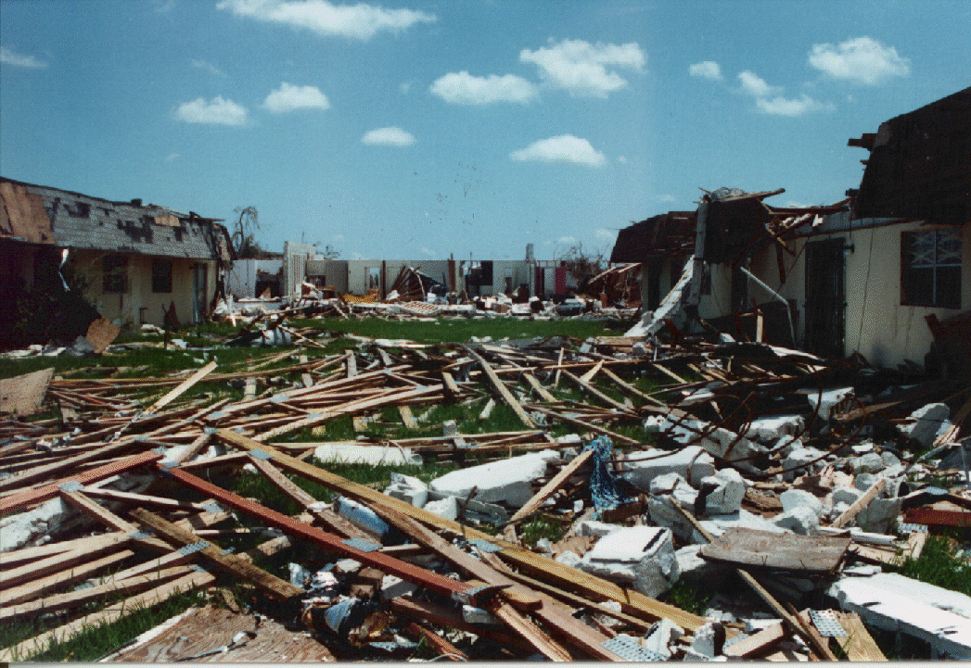
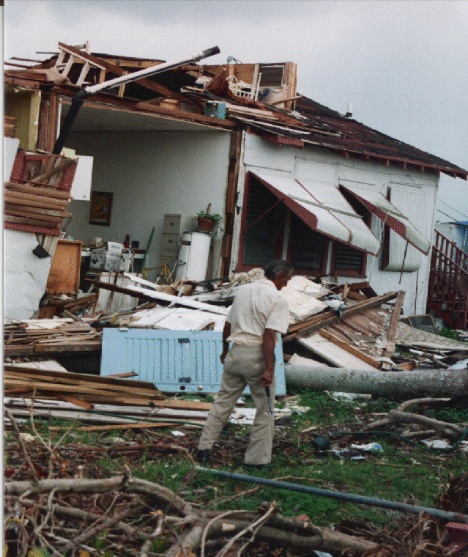
Damage from Hurricane Andrew
Sunday night and early Monday morning Andrew's winds reached 145 miles an hour with gusts of 175. More than 80,000 dwellings were demolished or damaged too severely to live in when its fury was unleashed on the coast of Florida. Another 55,000 homes were damaged, but still considered livable. Andrew moved on from Florida and surged ashore in Louisiana killing 15 people and doing billions more in damage.

Slide 13
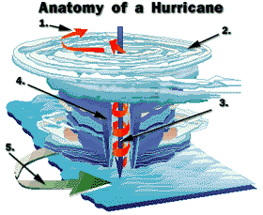
Anatomy of a Hurricane
List each name and number beside anatomy of hurricane
EXHAUST
STORM CLOUDS
EYE
EYE WALL
SPIRALING WINDS
Notes:
1. Exhaust
Hot air drawn into the atmosphere.
2. Storm clouds
Spiral in upper atmosphere.
3. Eye
Cool air descends into the 20-mile wide eye, creating a small center of calm weather.
4. Eye wall
Storm's fiercest winds.
5. Spiraling winds
In the hurricane's lower realms, air flows in towards the center and whirls upward. These counterclockwise winds gain speed as they approach the eye, like a whirlpool. The narrower the eye, the stronger the wind.

Slide 14
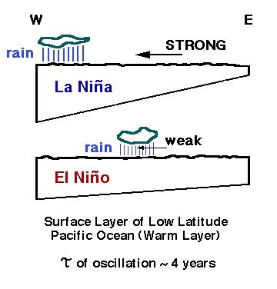
What is the difference between
La Niña and El Niño?
El Niño and La Niña are extreme phases of a naturally occurring climate cycle referred to as El Niño/Southern Oscillation (ENSO). Both terms refer to large-scale changes in sea-surface temperature across the eastern tropical Pacific. Usually, sea-surface readings off South America's west coast range from the 60s to 70s F, while they exceed 80 degrees F in the "warm pool" located in the central and western Pacific. This warm pool expands to cover the tropics during El Niño, but during La Niña, the easterly trade winds strengthen and cold upwelling along the equator and the West coast of South America intensifies. Sea-surface temperatures along the equator can fall as much as 7 degrees F below normal.

Slide 15
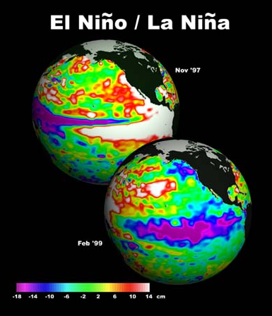
Why do El Niño and La Niña occur?
El Niño and La Niña result from interaction between the surface of the ocean and the atmosphere in the tropical Pacific. Changes in the ocean impact the atmosphere and climate patterns around the globe. In turn, changes in the atmosphere impact the ocean temperatures and currents. The system oscillates between warm (El Niño) to neutral (or cold La Niña) conditions with an on average every 3-4 years.

Slide 16
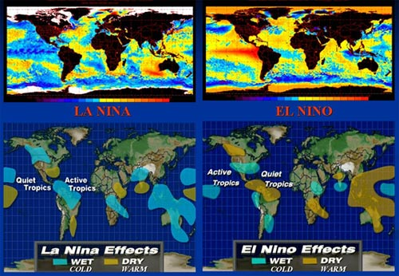
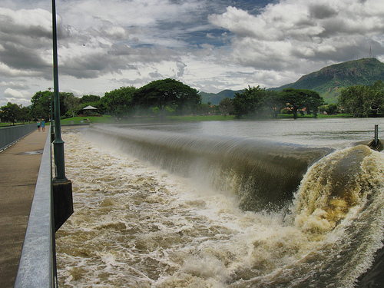
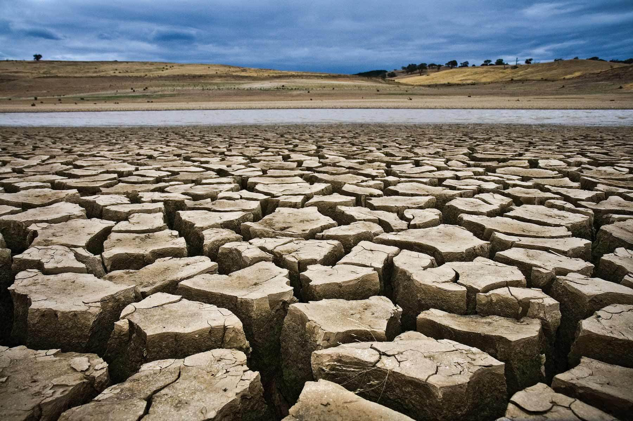
What are the global impacts of La Niña?
Both El Niño and La Niña impact global and U.S. climate patterns. In many locations, especially in the tropics, La Niña (or cold episodes) produces the opposite climate variations from El Niño. For instance, parts of Australia and Indonesia are prone to drought during El Niño, but are typically wetter than normal during La Niña.

Slide 17
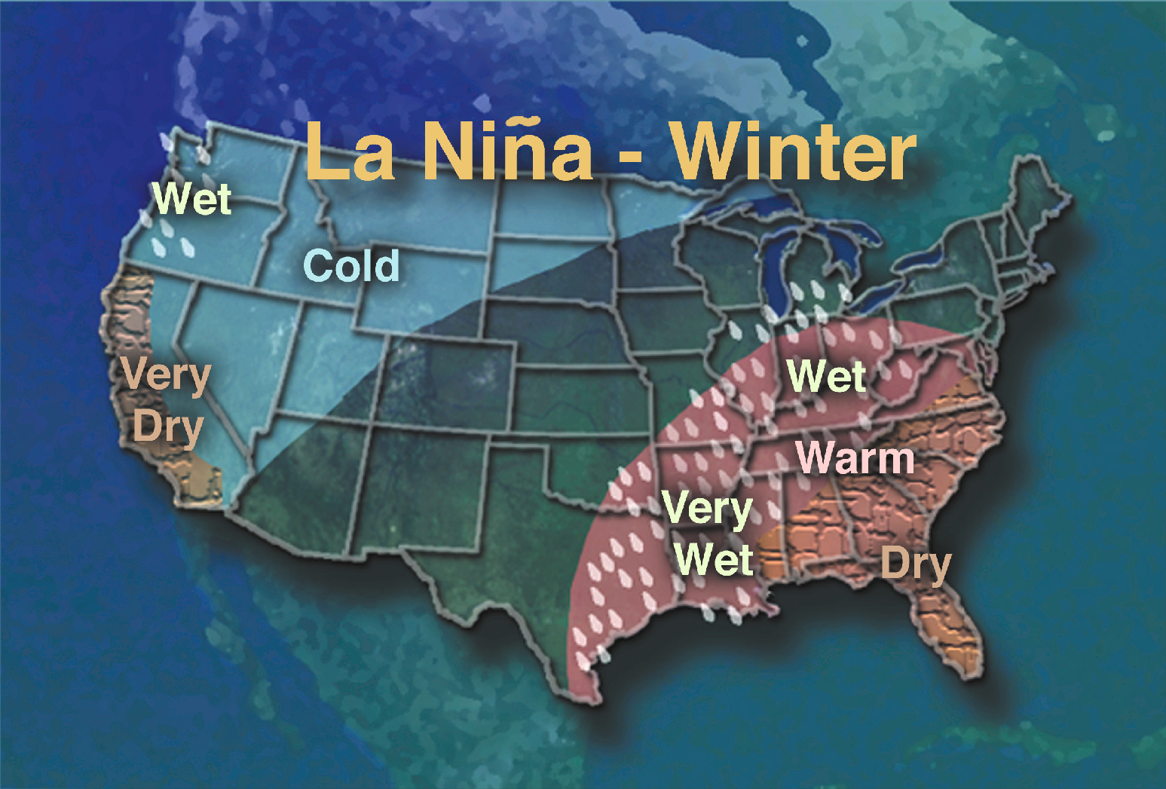
What are the U.S. impacts of La Niña?
La Niña often features drier than normal conditions in the Southwest in late summer through the subsequent winter. Drier than normal conditions also typically occur in the Central Plains in the fall and in the Southeast in the winter. In contrast, the Pacific
Northwest is more likely to be wetter than normal in the late fall and early winter with the presence of a well-established La Niña. Additionally, on average La Niña winters are warmer than normal in the Southeast and colder than normal in the Northwest.

Slide 18
How often does La Niña occur?
El Niño and La Niña occur on average every 3 to 5 years. However, in the historical record the interval between events has varied from 2 to 7 years. According to the National Centers for Environmental Prediction, this century's previous La Niñas began in 1903, 1906, 1909, 1916, 1924, 1928, 1938, 1950, 1954, 1964, 1970, 1973, 1975, 1988, and 1995. These events typically continued into the following spring. Since 1975, La Niñas have been only half as frequent as El Niños

Slide 19
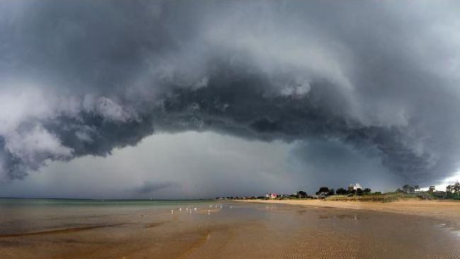
How long does a La Niña last?
La Niña conditions typically last approximately 9-12 months. Some episodes may persist for as long as two years.

Slide 20
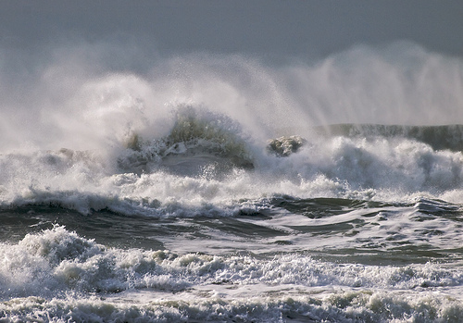
How Does El Niño Affect Storms?
During an El Niño - when the central Pacific is warming - there are fewer Atlantic storms. El Niños shift where storms form, but not the number, for the northwest Pacific and the southwest Pacific. The central Pacific gets more storms during El Niño and the year after.

