Slide 1
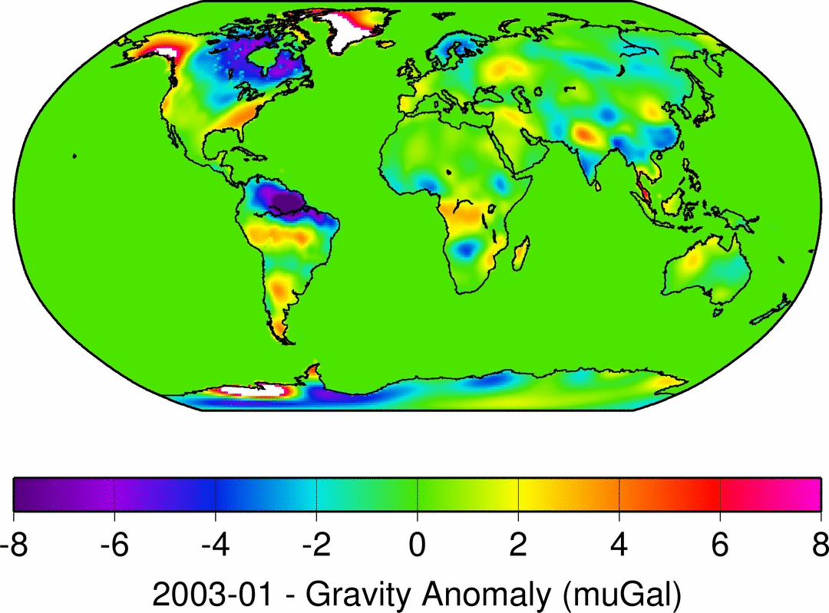
Notes:
This is a higher resolution loop of the annual water variability shown in the upper right of the next slide.

Slide 2
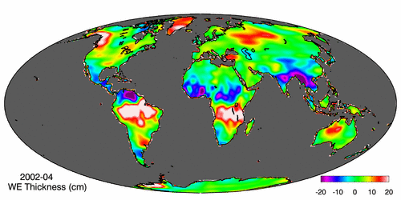
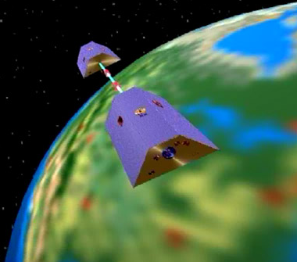
Collecting Water Data Globally (GRACE) Force of gravity responds to changes in water volume Water is really heavy!
Gravity Anomaly of Texas, 2003 – 2012
Normal
In 2011, we lost 75 Km³ of water or 53 Lake Travis’s
Notes:
Top Left Grace satellite pair that orbit in formation to measure the global gravity change, which is related to the global mass flux. The mass flux is mostly water at the seasonal time scales.
Top Right The global water variation, mapped at monthly intervals. The major river basins gain and loose water during each annual cycle. The red is water excess and the blue is water loss.
The bottom represents the total water storage over Texas during the last decade. The drought in 2005 and 2006 and the drought in 2001 are shown by low values for the total water storage.

